Slide 1
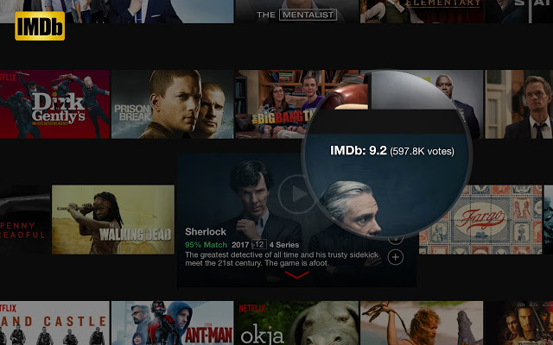

NeoAge Cinema – A step forward
A report by Sujay Sarkar of DeepRoot Analytica

Slide 2
Problem Statement
NeoAge Cinema, a production company had been running in losses for the past 3 years.
In 2017, the new management of NeoAge Cinema decides to produce movies that will earn the best in terms of Revenue, Popularity and Critical Acclaim.
NeoAge Cinema approaches DeepRoot Analytica in the beginning of year 2017.
NeoAge Cinema aims to produce movies that earn highest Revenue, Rating and Critical Acclaim.
NeoAge Cinema wants to find out the characteristics of movies that could earn them highest Revenue, Rating and Critical Acclaim.
NeoAge Cinema also wants to know about
Movie Industry Growth
Right time to invest in the movie Industry

Slide 3
Background
For an insight into NeoAge Cinema’s need, IMDB Most Popular 1000 movies dataset from 2006-2016 would be used.
IMDB (Internet Movie Database) is a popular online database for movies, television programs etc.
Registered users rate movies on a scale of 1 to 10 on IMDB.
IMDB Rating is a weighted-Mean Rating displayed beside each movie title.
IMDB also displays rating from metacritic.com as Metascore

Slide 4
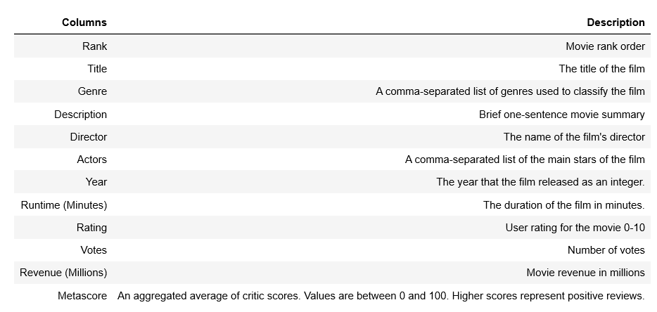
Data Definition
The data dictionary describing the different columns in the dataset.

Slide 5
Dataset At A Glance
The IMDB Movie Dataset consists of 1000 rows (movies) and 12 columns (Rank, Title, Rating, Director etc.)
During pre-processing, identified missing values in columns: Revenue - 13% (High) , Metascore - 6% (Not so high).
Reconcile missing values in columns:
Revenue – Replace by Median Revenue value.
Metascore – Dropped rows with missing values.
After cleanup, the dataset has 936 rows and 12 columns.
There is no incorrect datatypes.
The relationship of Genre, Director, Runtime of movies against Revenue, Rating and Metascore to provide significant insights into the industry.

Slide 6
Steps Followed
Understand the dataset
With the help of pandas profiling, find which columns require preprocessing.
Clean up the dataset.
Identified several questions to find out the relationship of Genre, Director and Runtime of movies against Revenue, Rating and Metascore.
Explored the dataset based on the questions using statistics and visualization.
Explored the impact of Director on a movie’s Revenue, Rating and Metascore.
Explored the impact of Runtime of a movie based on 4 categories: Short (<100 mins), Medium(100-111 mins), Moderately Long(111-123 mins) and Long(>123 mins)
Analyzed the Revenue, Rating and Metascore for the movies against these categories.

Slide 7
Steps Followed (Contd..)
Explored the effect of Genre count on a movie’s Revenue, Rating and Metascore.
Explored the effect of Genre combination on a movie’s Revenue, Rating and Metascore.
Analyzed the growth of movie industry over the 10 year period in terms of Revenue and Rating.
Explored the correlation between Revenue, Rating and Metascore.
Drew conclusions from the findings from all the exploration.
Found out actionable insights based on the findings.

Slide 8
EXPLORATION AND FINDINGS

Slide 9
Movie Industry Trend

Slide 10
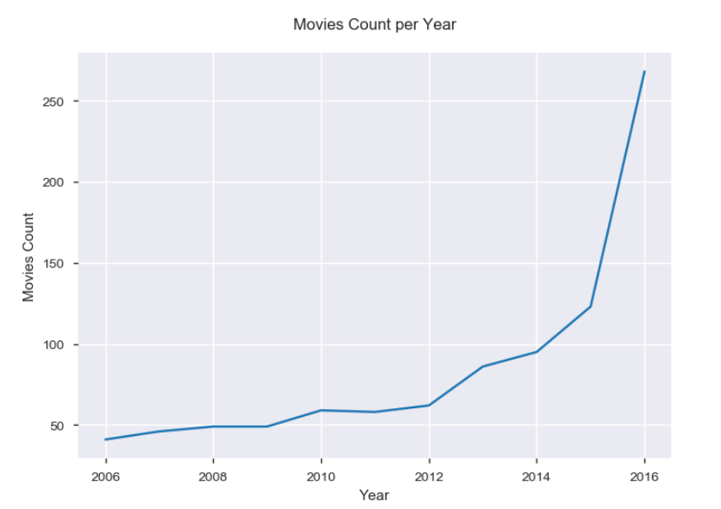
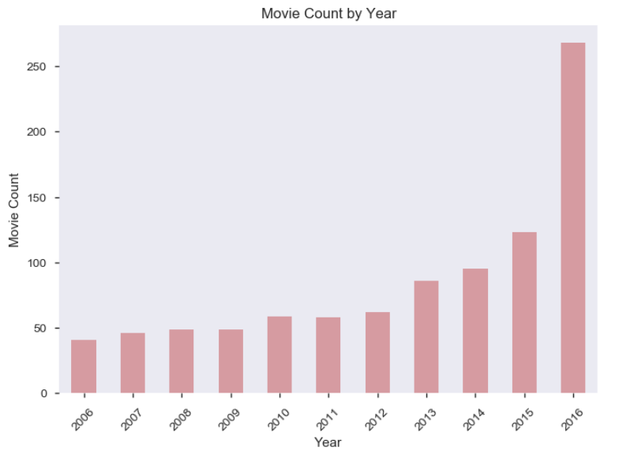
Industry Trend With Respect To Movie Count
Industry is growing with respect to number of movies released year on year.
118% increase in the number of movies released in 2016, compared to 2015.

Slide 11
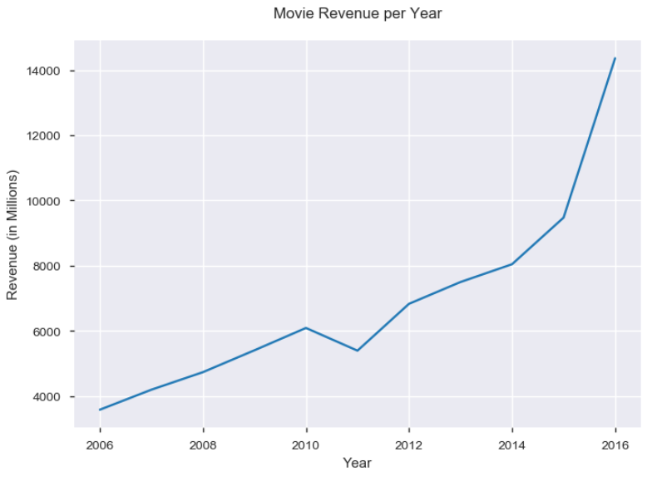
Industry Trend With Respect To Total Revenue
There is an upward trend in the overall Revenue from movies.
Significant increase in the revenue from movies released in 2016, compared to 2015.
This is in correlation with the increase in the number of movies released in 2016.

Slide 12
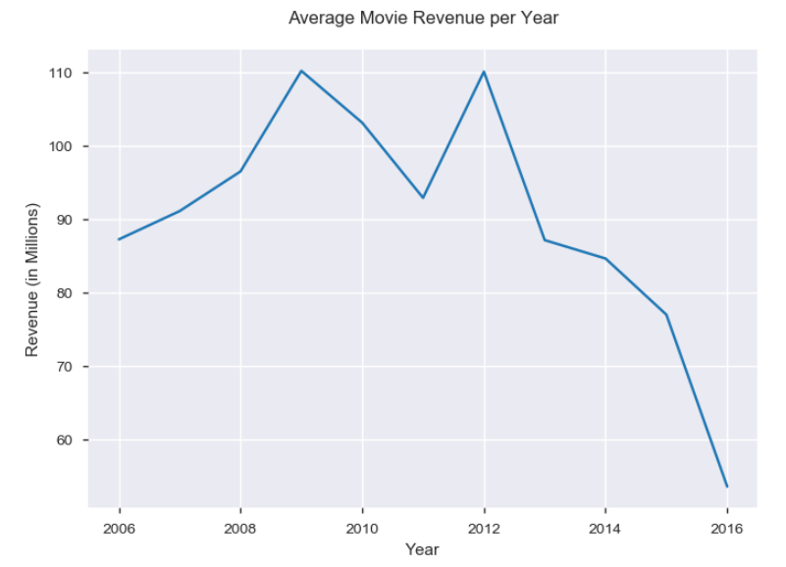
Industry Trend With Respect To Average Revenue
There is a decreasing trend in the average Revenue.
Competition is increasing and more movies are released per year.
Total revenue gets distributed among many movies.

Slide 13
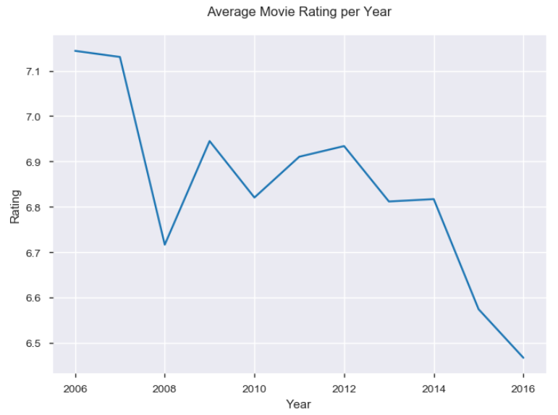
Industry Trend With Respect To Popularity Rating
There is a downtrend in the Popularity Rating of movies over the years.
More movies are being produced, however the Genre combination may not be to the likeness of viewers.

Slide 14
Directors’ Influence

Slide 15
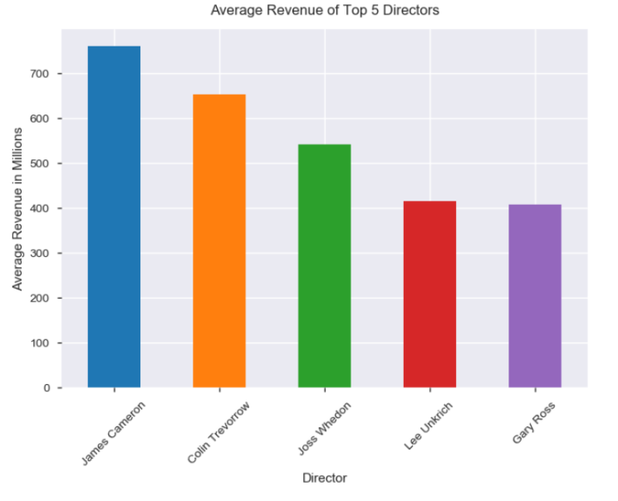
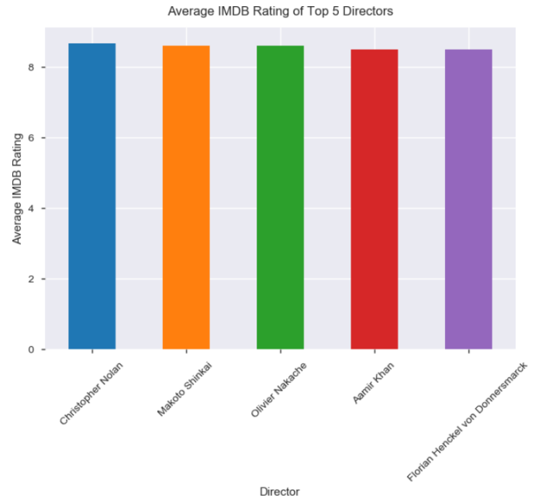
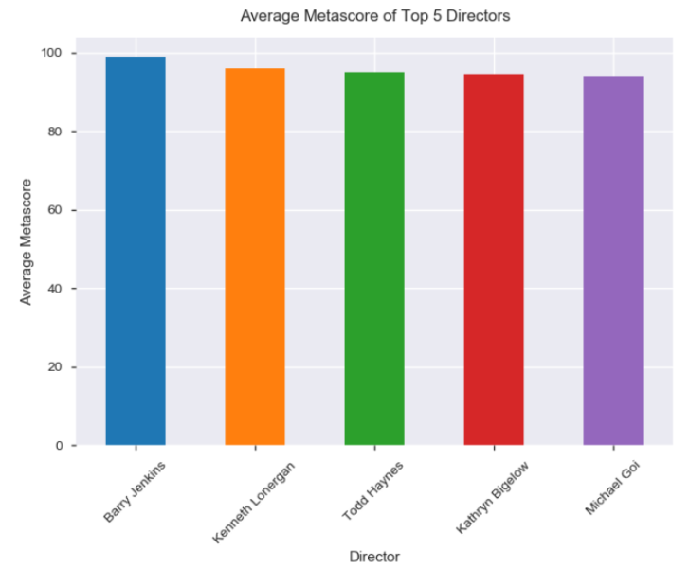
Top 5 Directors: Average Revenue, Average Rating And Average Metascore
The graphs shows the average Revenue, Rating and Metascore of the Top 5 Directors.
James Cameron, Christopher Nolan and Barry Jenkins tops the list in specific areas.
Number of movies produced by each Director varies.
James Cameron has produced only 1 movie.

Slide 16
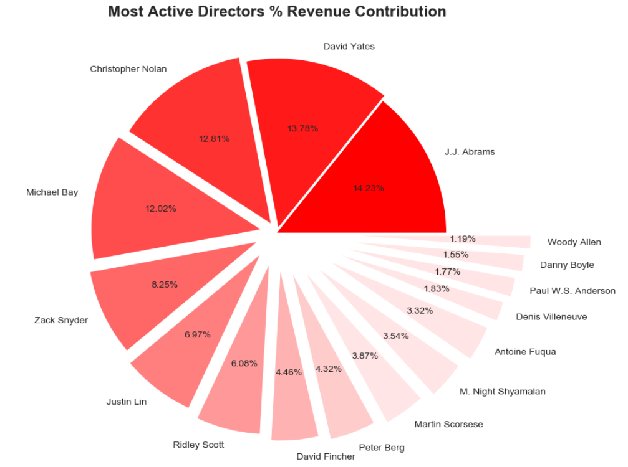
% Revenue Contribution by Active Directors
Identified top Directors: who have directed 5 or more movies in a year.
JJ Abrams tops the list with highest revenue contribution.
Since the number of movies directed and produced are different, the total percentage revenue may not be a good figure to ascertain a Directors success.
Average Revenue generated by the active Directors is a good measure.

Slide 17
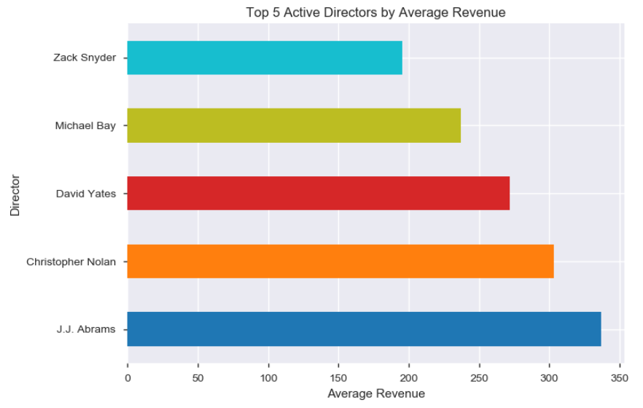
Top 5 Active Directors By Average Revenue
The top 5 active Directors by average revenue are JJ Abrams, Christopher Nolan, David Yates, Michael Bay and Zack Snyder.
J J Abrams's movies earn more in terms of average revenue.
Closely followed by Christopher Nolan.

Slide 18
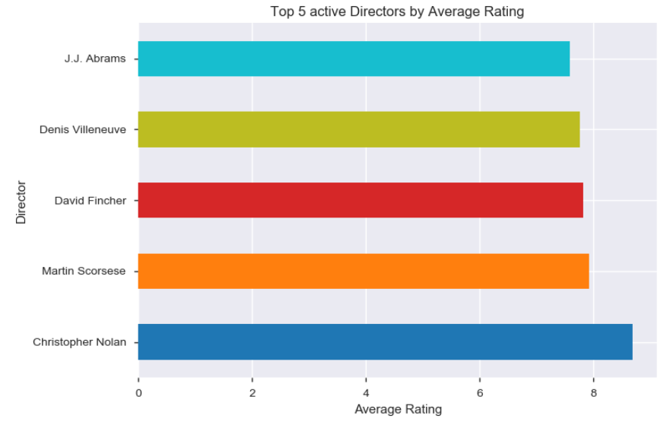
Top 5 Active Directors By Average IMDB Rating
The top 5 active Directors by average rating are Christopher Nolan, Martin Scorsese, David Fincher, Denis Villeneuve and JJ Abrams.
Christopher Nolan is the most popular active director in terms of average rating among people.

Slide 19
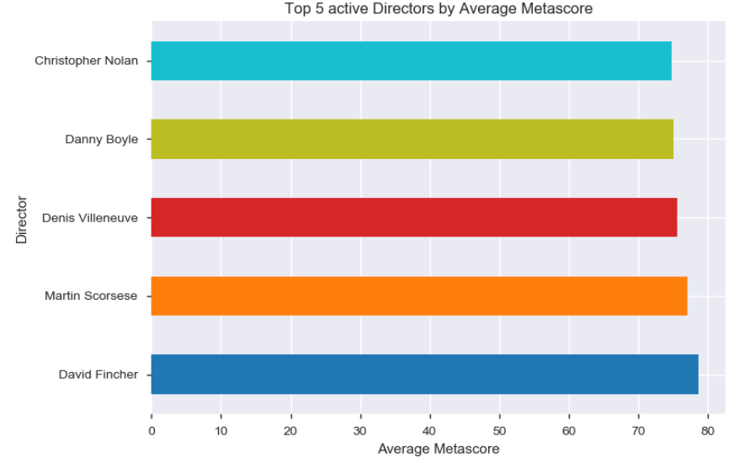
Top 5 Active Directors By Average Metascore
The top 5 active Directors by average Metascore are David Fincher, Martin Scorsese, Denis Villeneuve, Danny Boyle and Christopher Nolan.
Critics favour David Fincher in terms of average Metascore.
Christopher Nolan also features in the list.

Slide 20
Movie Runtime Influence

Slide 21
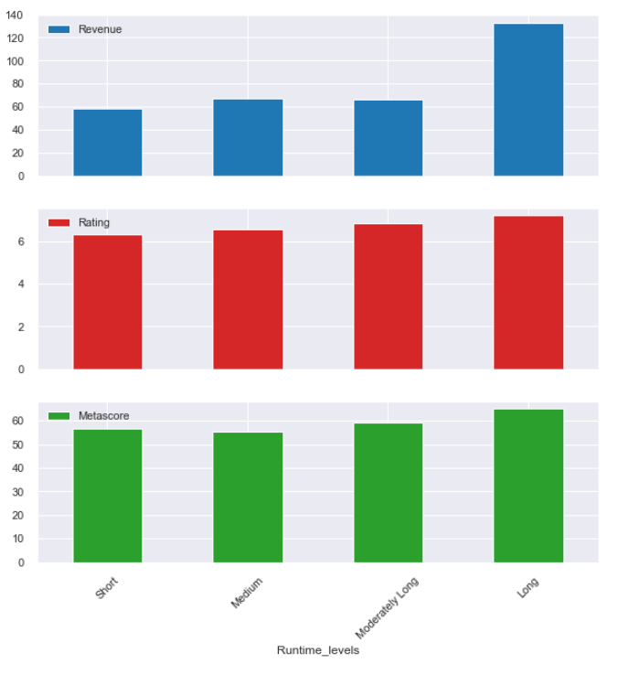
Impact Of Runtime On Movies
As the Runtime increases the movies tends to earn higher Revenue, higher Popularity and higher Critical Acclaim.
Movies with Long Runtimes (> 123 minutes) earn more in terms of Revenue, Rating and Metascore.

Slide 22
Movie Genre Influence

Slide 23
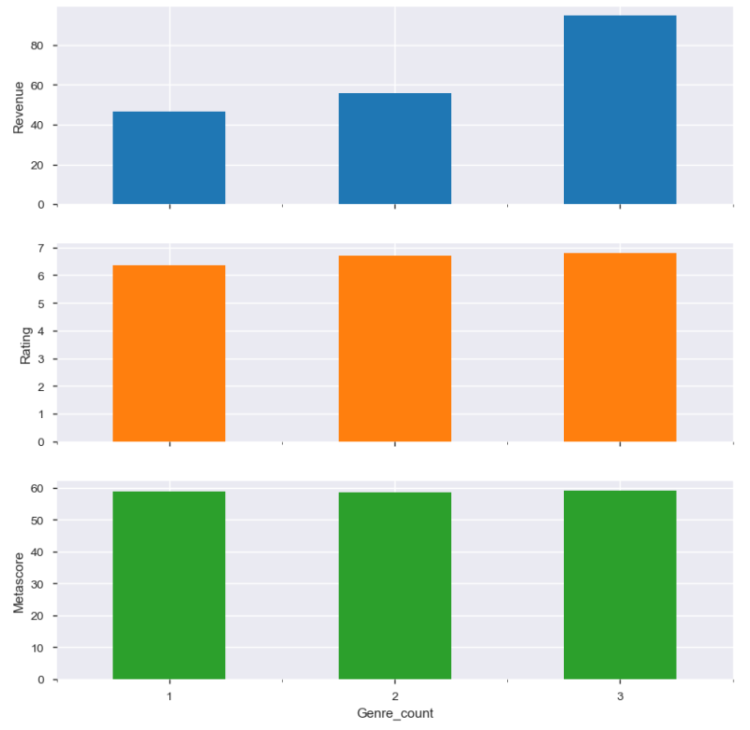
Impact of Genre Count on Movies
As the Genre count increases in a movie, its Revenue, Rating and Metascore also increases.
Revenue is significantly high for movies with Genre count of 3.

Slide 24
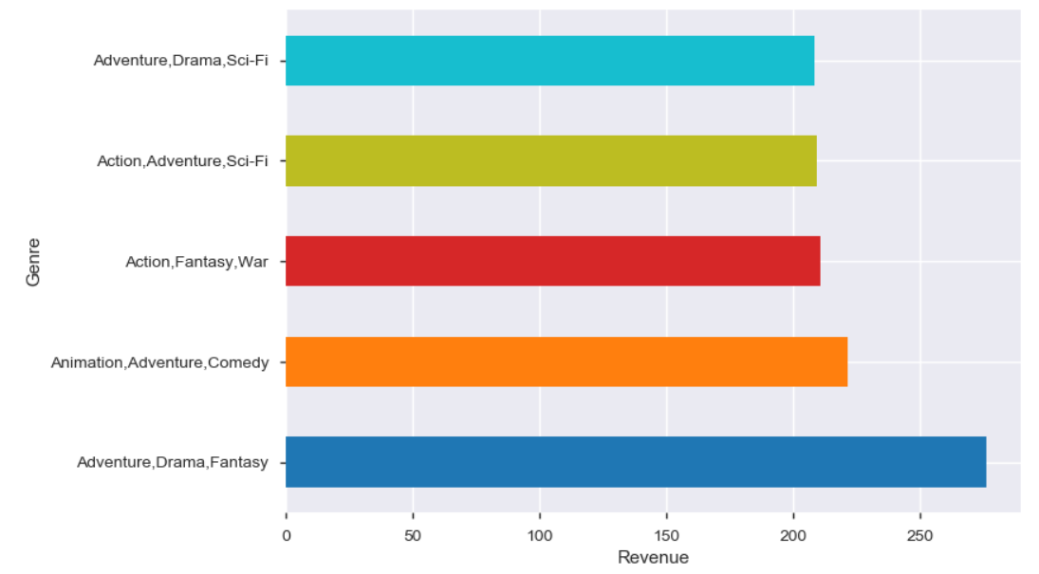
Impact of Genre Combination on Revenue
The Genre combination of "Adventure, Drama, Fantasy" earns the highest Revenue
Adventure as Genre is a common factor in the top 5 Genre for movies that brings in more revenue

Slide 25
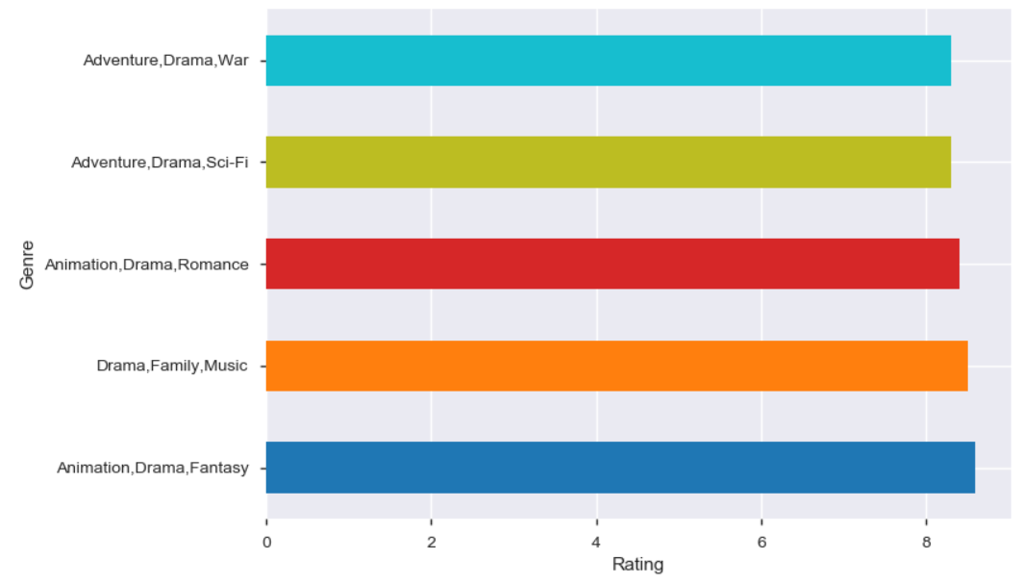
Impact of Genre Combination on Rating
The Genre combination of "Animation, Drama, Fantasy" earns the highest Rating.
Drama is the most popular Genre.

Slide 26
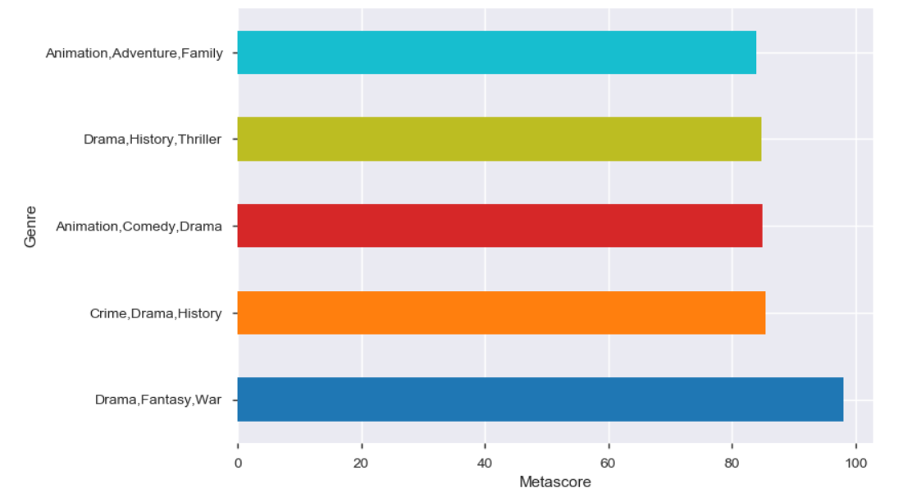
Impact of Genre Combination on Metascore
The Genre combination of "Drama, Fantasy, War" earning the highest Metascore.
Drama is the most popular among critics.

Slide 27
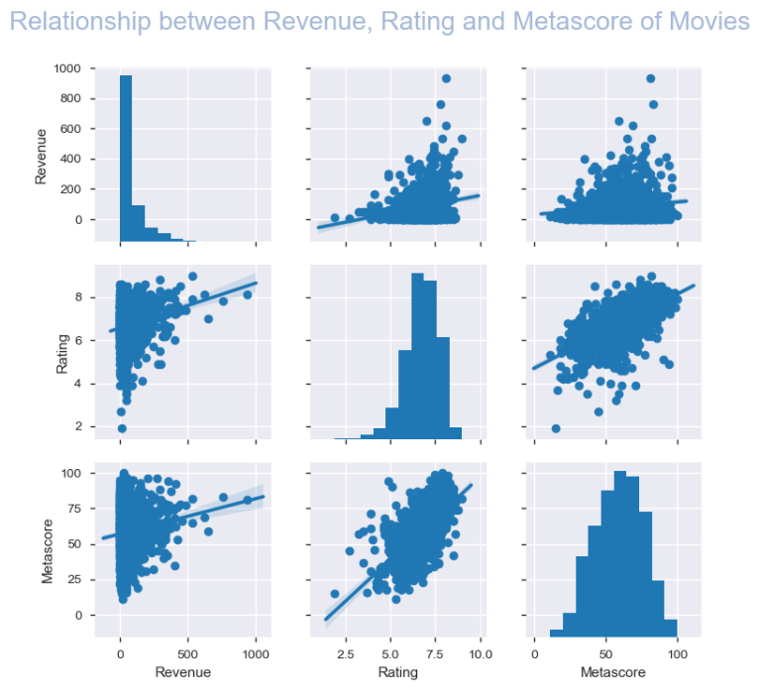
Correlation: Revenue, Rating and Metascore
Rating and Metascore have strong correlation.
As the Rating increases, the Revenue also tends to increase
As the Metascore increases, the Revenue also tends to increase.
The IMDB users and Critics tend to agree with each other.

Slide 28
Actionable Insights

Slide 29
What’s Next For NeoAge Cinema?
Based on the assessment and findings, following are proposed to NeoAge Cinema as steps to move forward:
Produce multiple movies with best features instead of looking to produce only one
Produce movies with Active and the most Directors
Produce movies with Moderately Long to Long Runtimes
Produce movies with 3 Genre combination
Produce movies that will satisfy both People and Critics
Note: Refer to the report for more details

Slide 30
THANK YOU
Sujay_kelvin@yahoo.com

